Slide 1

CS 3043 Database Systems Chapter 1: Introduction

Slide 2

Introduction
Learning Outcomes (CS 3042)
After completing this module, students should be able to
explain the role of database systems in information management.
describe the basic fundamental concepts of data modelling and relational databases.
apply entity-relationship modelling and normalization for simple database requirements.
demonstrate the use of a query language to create, update and query a simple database.
construct simple applications that requires manipulating data in a DBMS.
Recommended Text: Silberschatz, Korth and Sudarshan Database System Concepts, 7th Edition, McGraw-Hill 2 McGraw Hill.
Slides are based on the slides provided with this book

Slide 3

Grading Scheme
Method of Assessment:
2 hour closed book examination - 60%
Continuous assessments - 40%
Breakdown of the Continuous Assessments
Marks:
2-hour closed book end of semester examination - 60%
Mini project (Group) - 20%
Mid Term Quiz (Moodle) - 10 %
In-class/lab pop quizzes/labs - 10 %

Slide 4

Database Management System (DBMS)
DBMS contains information about a particular enterprise
Collection of interrelated data
Set of programs to access the data
An environment that is both convenient and efficient to use
Database Applications:
Banking: transactions
Airlines: reservations, schedules
Universities: registration, grades
Sales: customers, products, purchases
Online retailers: order tracking, customized recommendations
Manufacturing: production, inventory, orders, supply chain
Human resources: employee records, salaries, tax deductions
Databases can be very large.
Databases touch all aspects of our lives

Slide 5
University Database Example
Application program examples
Add new students, instructors, and courses
Register students for courses, and generate class rosters
Assign grades to students, compute grade point averages (GPA) and generate transcripts
In the early days, database applications were built directly on top of file systems

Slide 6
Drawbacks of using file systems to store data
Data redundancy and inconsistency
Multiple file formats, duplication of information in different files
Difficulty in accessing data
Need to write a new program to carry out each new task
Data isolation — multiple files and formats
Integrity problems
Integrity constraints (e.g., account balance > 0) become “buried” in program code rather than being stated explicitly
Hard to add new constraints or change existing ones

Slide 7
Drawbacks of using file systems to store data (Cont.)
Atomicity of updates
Failures may leave database in an inconsistent state with partial updates carried out
Example: Transfer of funds from one account to another should either complete or not happen at all
Concurrent access by multiple users
Concurrent access needed for performance
Uncontrolled concurrent accesses can lead to inconsistencies
Example: Two people reading a balance (say 100) and updating it by withdrawing money (say 50 each) at the same time
Security problems
Hard to provide user access to some, but not all, data
Database systems offer solutions to all the above problems

Slide 8
Levels of Abstraction
Physical level: describes how a record (e.g., customer) is stored.
Logical level: describes data stored in database, and the relationships among the data.
type instructor = record
ID : string; name : string; dept_name : string; salary : integer;
end;
View level: application programs hide details of data types. Views can also hide information (such as an employee’s salary) for security purposes.

Slide 9
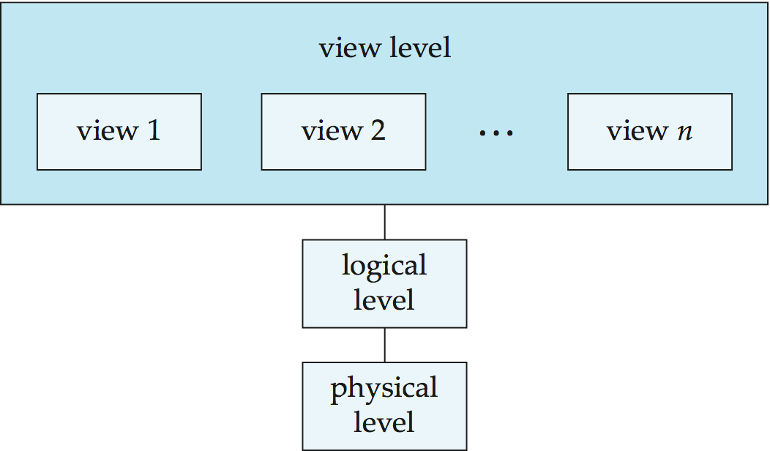
View of Data
An architecture for a database system

Slide 10
View of Data
An architecture for a database system
Marketing Manager
Branch Manager
Bank Teller
Name
Balance
Name
Balance
Branch
AccNo
Name
Balance
Branch
AccNo Integer
Name Varchar (30)
Balance Integer
Branch Varchar(10)
File Account, Type, offset, location etc…..

Slide 11
Instances and Schemas
Similar to types and variables in programming languages
Schema – the logical structure of the database
Example: The database consists of information about a set of customers and accounts and the relationship between them
Analogous to type information of a variable in a program
Physical schema: database design at the physical level
Logical schema: database design at the logical level
Instance – the actual content of the database at a particular point in time
Analogous to the value of a variable
Physical Data Independence – the ability to modify the physical schema without changing the logical schema
Applications depend on the logical schema
In general, the interfaces between the various levels and components should be well defined so that changes in some parts do not seriously influence others.

Slide 12
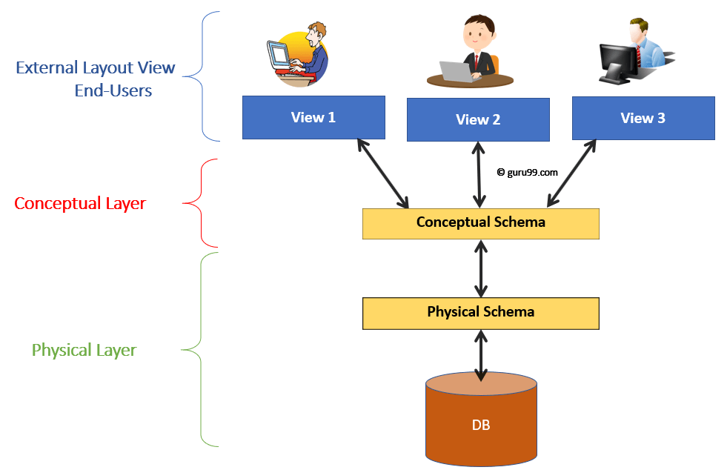
Physical Data Independence
(Logical Layer)
Oracle
MS-SQL
MySQL

Slide 13
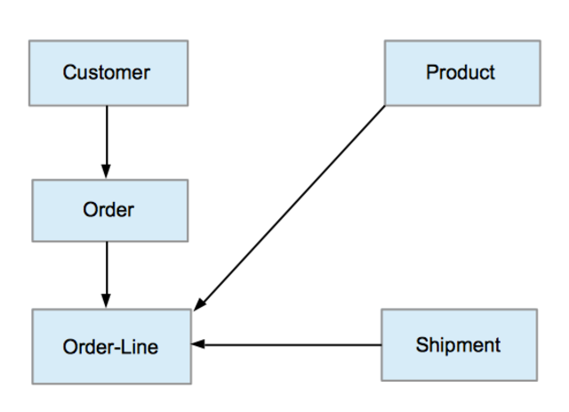
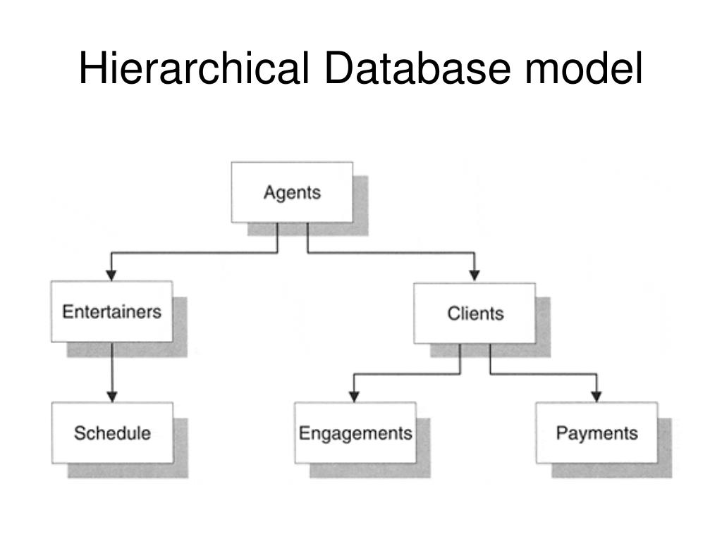
Data Models
A collection of tools for describing
Data
Data relationships
Data semantics
Data constraints
Relational model
Entity-Relationship data model (mainly for database design)
Object-based data models (Object-oriented and Object-relational)
Semistructured data model (XML)
Other older models:
Network model
Hierarchical model

Slide 14

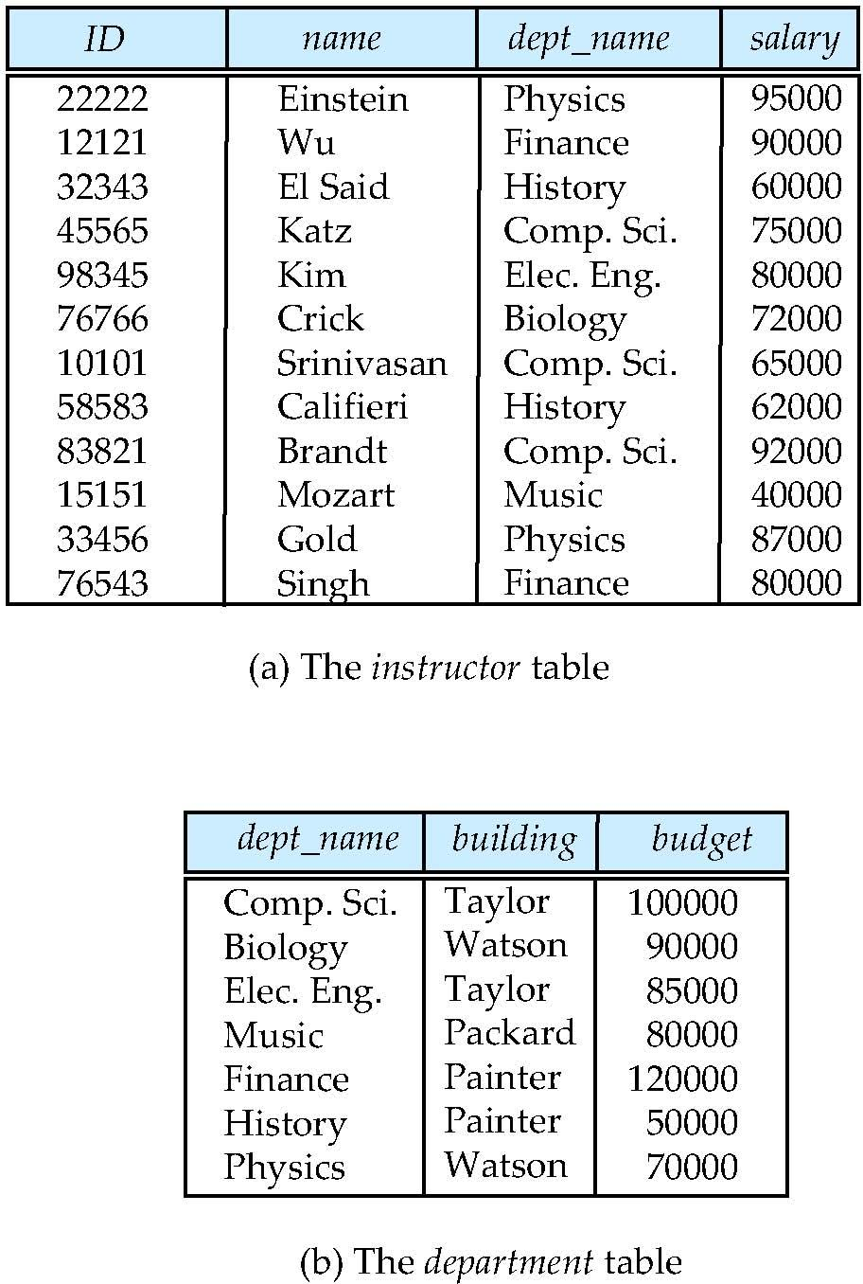
Relational Model
Relational model (Chapter 2)
Example of tabular data in the relational model
Columns
Rows

Slide 15
A Sample Relational Database

Slide 16
Data Manipulation Language (DML)
Language for accessing and manipulating the data organized by the appropriate data model
DML also known as query language
Two classes of languages
Procedural – user specifies what data is required and how to get those data
Declarative (nonprocedural) – user specifies what data is required without specifying how to get those data
SQL is the most widely used query language

Slide 17
Data Definition Language (DDL)
Specification notation for defining the database schema
Example: create table instructor ( ID char(5), name varchar(20), dept_name varchar(20), salary numeric(8,2))
DDL compiler generates a set of table templates stored in a data dictionary
Data dictionary contains metadata (i.e., data about data)
Database schema
Integrity constraints
Primary key (ID uniquely identifies instructors)
Referential integrity (references constraint in SQL)
e.g. dept_name value in any instructor tuple must appear in department relation
Authorization

Slide 18
SQL
SQL: widely used non-procedural language
Example: Find the name of the instructor with ID 22222 select name from instructor where instructor.ID = ‘22222’
Example: Find the ID and building of instructors in the Physics dept.
select instructor.ID, department.building from instructor, department where instructor.dept_name = department.dept_name and department.dept_name = ‘Physics’
Application programs generally access databases through one of
Language extensions to allow embedded SQL
Application program interface (e.g., ODBC/JDBC) which allow SQL queries to be sent to a database
Chapters 3, 4 and 5

Slide 19
Database Design
The process of designing the general structure of the database:
Logical Design – Deciding on the database schema. Database design requires that we find a “good” collection of relation schemas.
Business decision – What attributes should we record in the database?
Computer Science decision – What relation schemas should we have and how should the attributes be distributed among the various relation schemas?
Physical Design – Deciding on the physical layout of the database

Slide 20
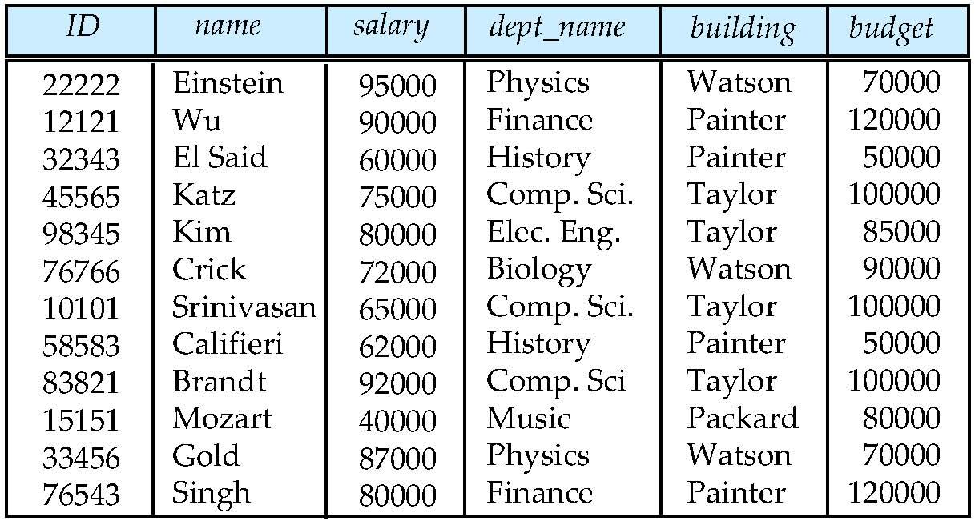
Database Design?
Is there any problem with this design?

Slide 21
Design Approaches
Normalization Theory (Chapter 7)
Formalize what designs are bad, and test for them
Entity Relationship Model (Chapter 6)
Models an enterprise as a collection of entities and relationships
Entity: a “thing” or “object” in the enterprise that is distinguishable from other objects
Described by a set of attributes
Relationship: an association among several entities
Represented diagrammatically by an entity-relationship diagram:

Slide 22
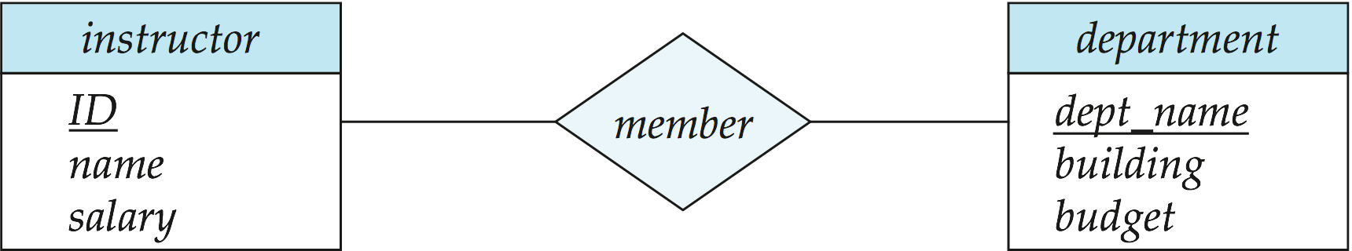
The Entity-Relationship Model
Models an enterprise as a collection of entities and relationships
Entity: a “thing” or “object” in the enterprise that is distinguishable from other objects
Described by a set of attributes
Relationship: an association among several entities
Represented diagrammatically by an entity-relationship diagram:
What happened to dept_name of instructor and student?

Slide 23
Object-Relational Data Models
Relational model: flat, “atomic” values
Object Relational Data Models
Extend the relational data model by including object orientation and constructs to deal with added data types.
Allow attributes of tuples to have complex types, including non-atomic values such as nested relations.
Preserve relational foundations, in particular the declarative access to data, while extending modeling power.
Provide upward compatibility with existing relational languages.

Slide 24
XML: Extensible Markup Language
Defined by the WWW Consortium (W3C)
Originally intended as a document markup language not a database language
The ability to specify new tags, and to create nested tag structures made XML a great way to exchange data, not just documents
XML has become the basis for all new generation data interchange formats.
A wide variety of tools is available for parsing, browsing and querying XML documents/data

Slide 25

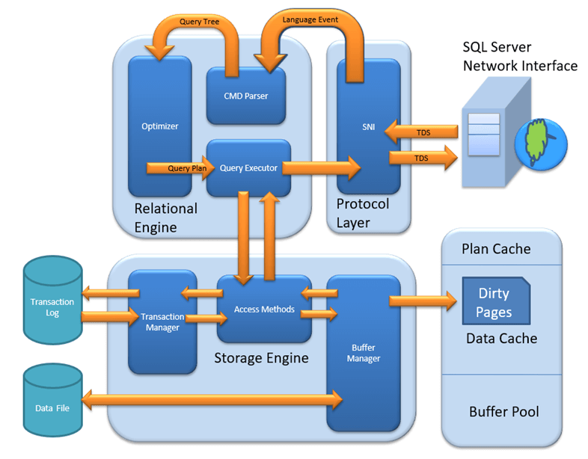
Database Engine
Storage manager
Query processing
Transaction manager

Slide 26
Storage Management
Storage manager is a program module that provides the interface between the low-level data stored in the database and the application programs and queries submitted to the system.
The storage manager is responsible to the following tasks:
Interaction with the file manager
Efficient storing, retrieving and updating of data
Issues:
Storage access
File organization
Indexing and hashing

Slide 27
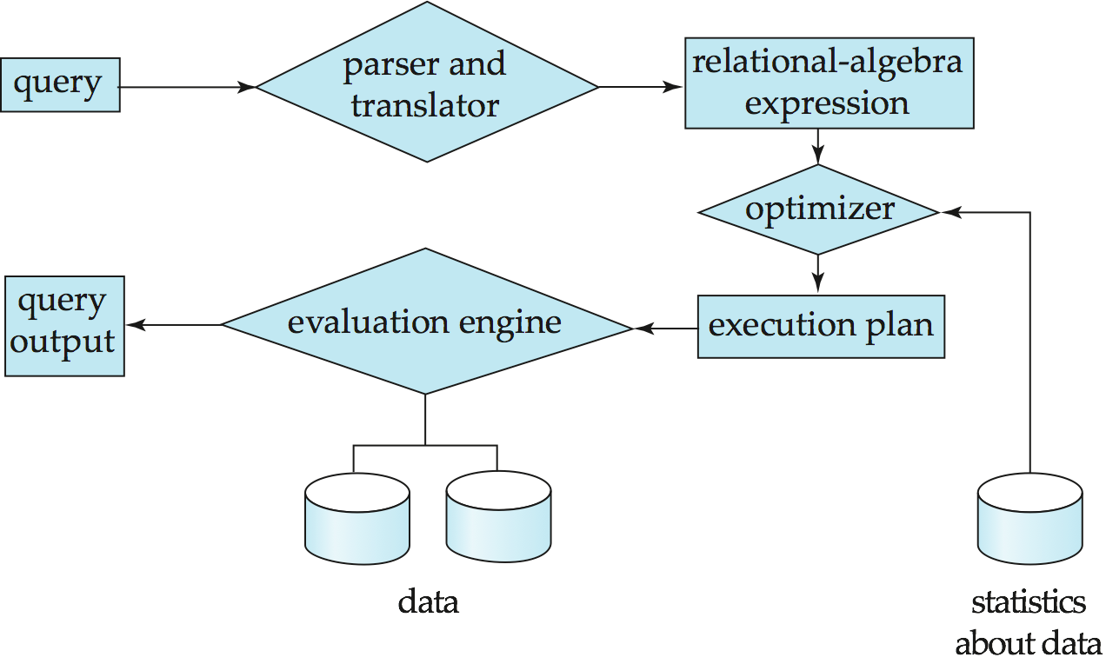
Query Processing
1. Parsing and translation
2. Optimization
3. Evaluation

Slide 28
Query Processing (Cont.)
Alternative ways of evaluating a given query
Equivalent expressions
Different algorithms for each operation
Cost difference between a good and a bad way of evaluating a query can be enormous
Need to estimate the cost of operations
Depends critically on statistical information about relations which the database must maintain
Need to estimate statistics for intermediate results to compute cost of complex expressions

Slide 29
Transaction Management
What if the system fails?
What if more than one user is concurrently updating the same data?
A transaction is a collection of operations that performs a single logical function in a database application
Transaction-management component ensures that the database remains in a consistent (correct) state despite system failures (e.g., power failures and operating system crashes) and transaction failures.
Concurrency-control manager controls the interaction among the concurrent transactions, to ensure the consistency of the database.

Slide 30
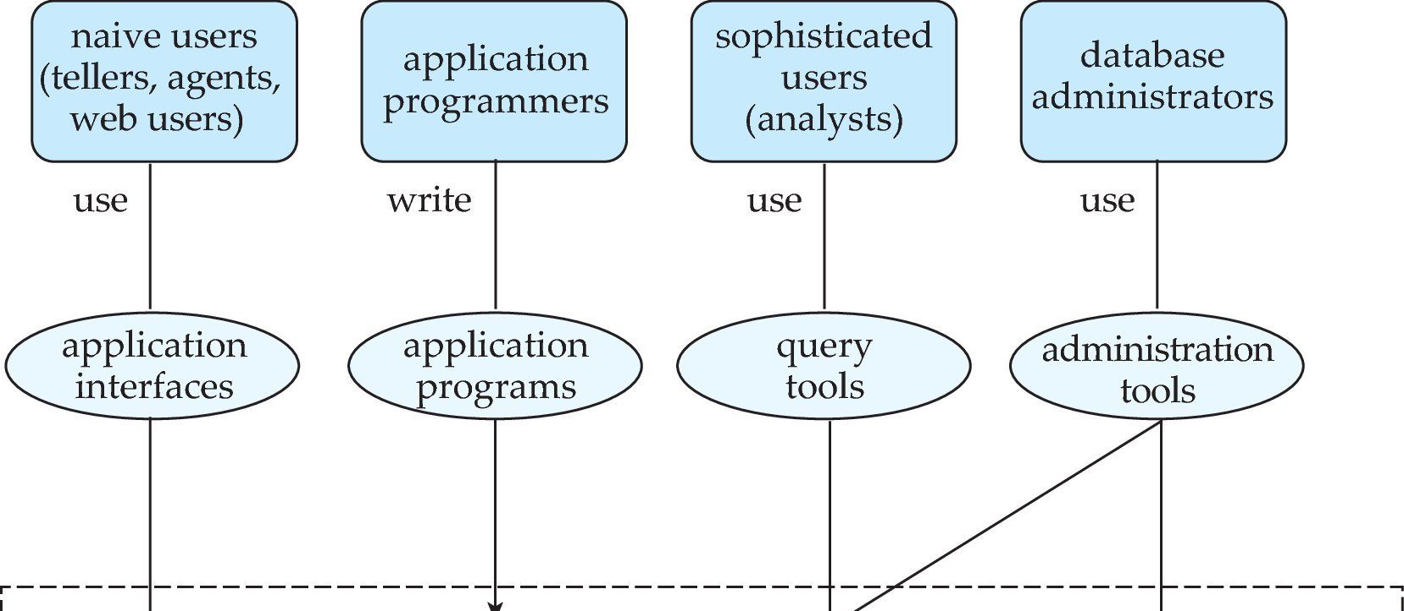
Database Users and Administrators
Database

Slide 31
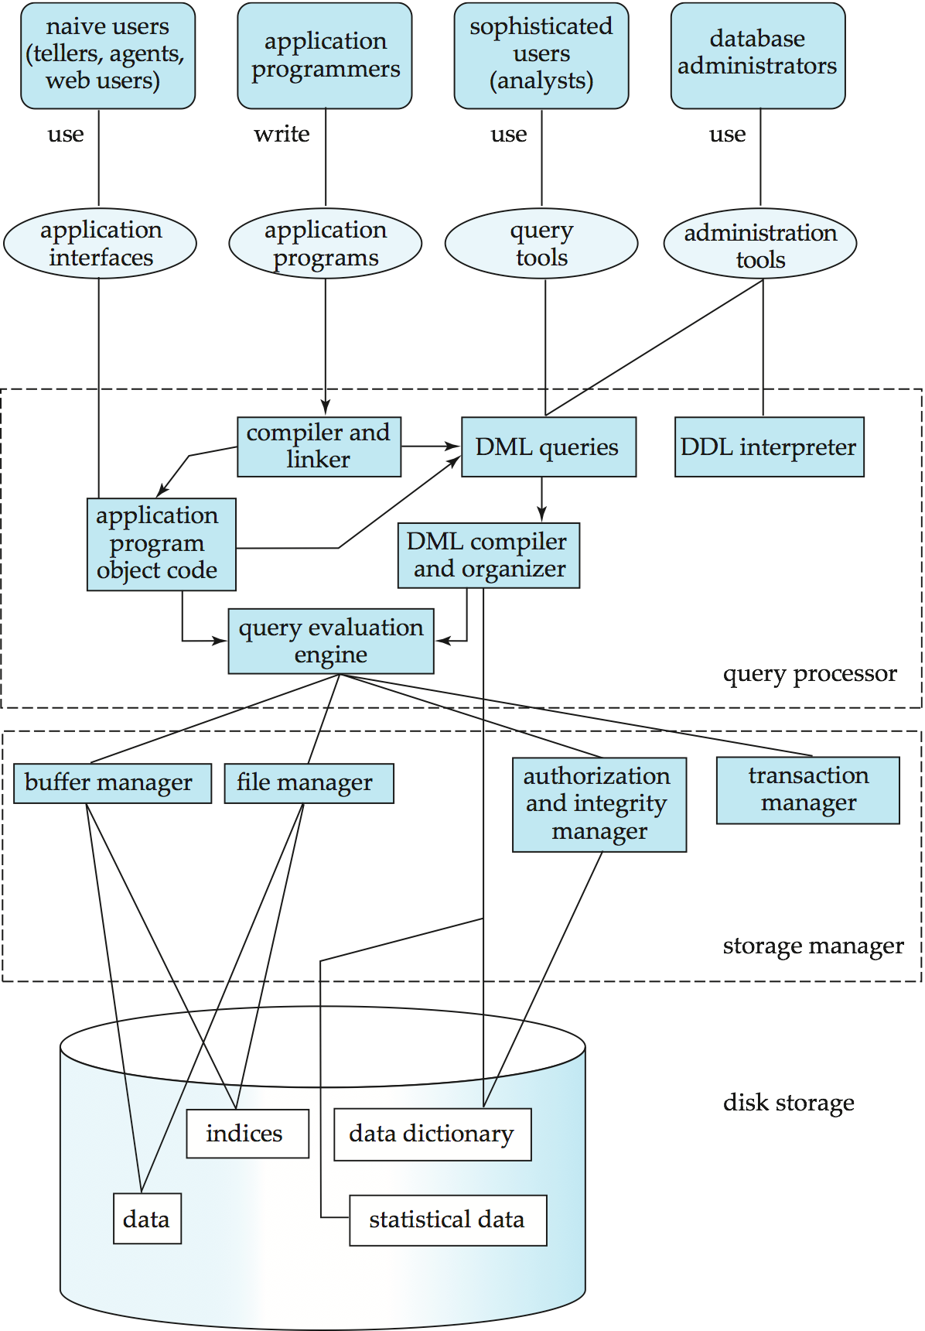
Database System Internals

Slide 32
Database Architecture
The architecture of a database systems is greatly influenced by
the underlying computer system on which the database is running:
Centralized
Client-server
Parallel (multi-processor)
Distributed

Slide 33
History of Database Systems
1950s and early 1960s:
Data processing using magnetic tapes for storage
Tapes provided only sequential access
Punched cards for input
Late 1960s and 1970s:
Hard disks allowed direct access to data
Network and hierarchical data models in widespread use
Ted Codd defines the relational data model
Would win the ACM Turing Award for this work
IBM Research begins System R prototype
UC Berkeley begins Ingres prototype
High-performance (for the era) transaction processing

Slide 34
History (cont.)
1980s:
Research relational prototypes evolve into commercial systems
SQL becomes industrial standard
Parallel and distributed database systems
Object-oriented database systems
1990s:
Large decision support and data-mining applications
Large multi-terabyte data warehouses
Emergence of Web commerce
Early 2000s:
XML and XQuery standards
Automated database administration
Later 2000s:
Giant data storage systems
Google BigTable, Yahoo PNuts, Amazon, ..

Slide 35
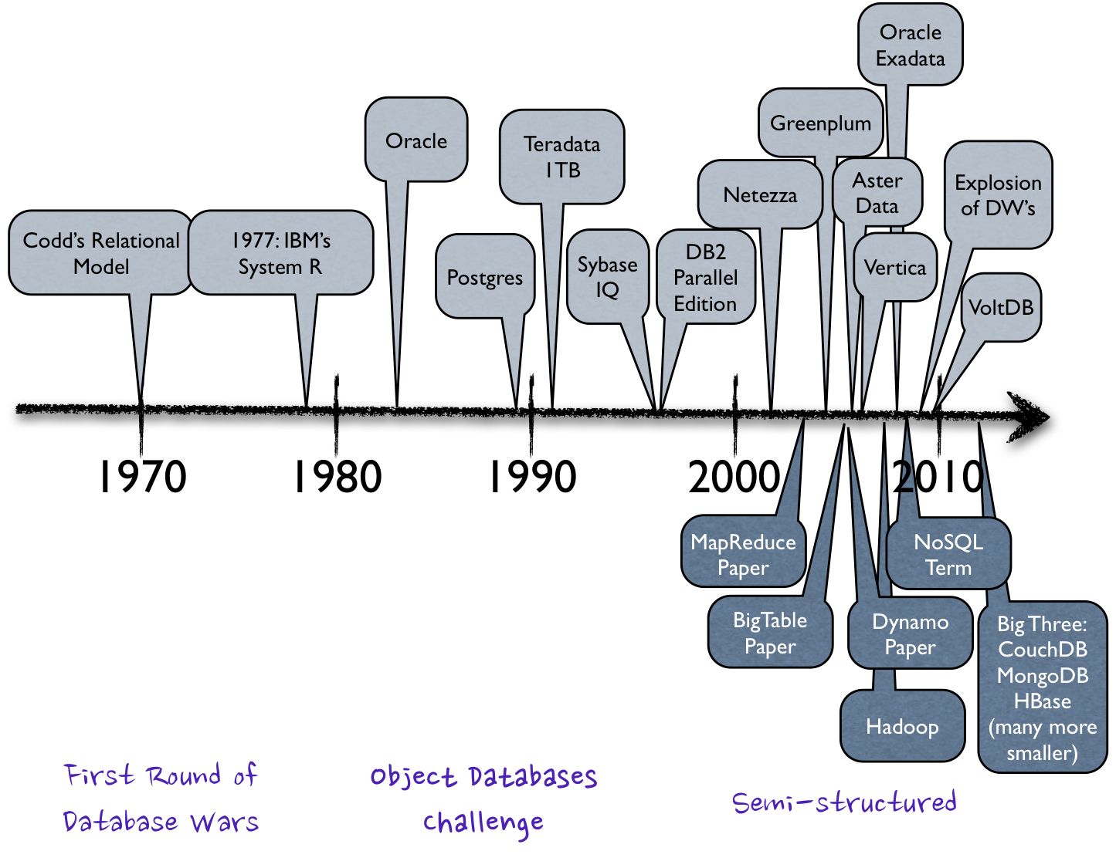
History of Database Systems

Slide 36
End of Chapter 1

Slide 37
Chapter 2: Intro to Relational Model
Notes:
37

Slide 38
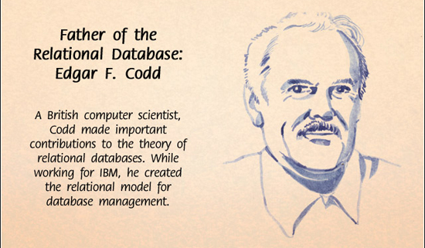

Slide 39
Exercise 1.1
Briefly explain 5 (five) reasons as to why you would use a DBMS for a university student registration system rather than a simple flat file.

Slide 40
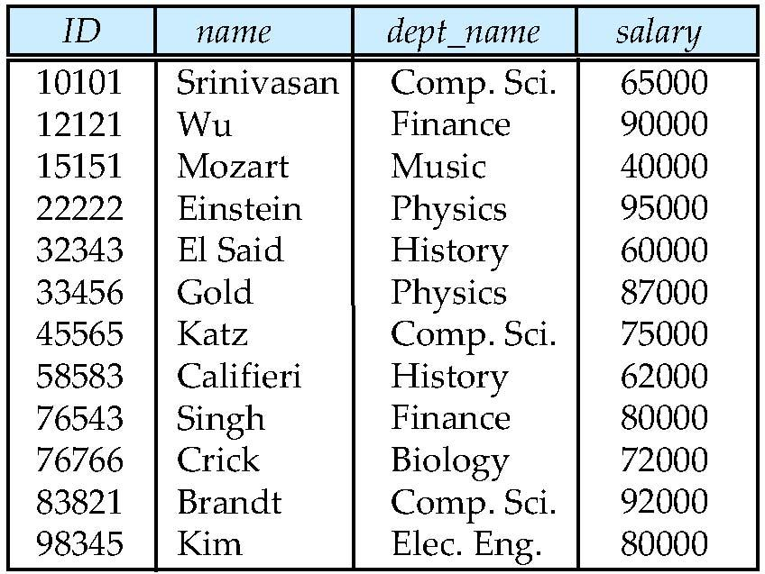
Example of a Relation
attributes
(or columns)
tuples
(or rows)
Notes:
40

Slide 41
Attribute Types
The set of allowed values for each attribute is called the domain of the attribute
Attribute values are (normally) required to be atomic; that is, indivisible
The special value null is a member of every domain
The null value causes complications in the definition of many operations
Notes:
41

Slide 42
Relation Schema and Instance
A₁, A₂, …, A_{n} are attributes
R = (A₁, A₂, …, A_{n} ) is a relation schema
Example:
instructor = (ID, name, dept_name, salary)
Formally, given sets D₁, D₂, …. D_{n} a relation r is a subset of D₁ x D₂ x … x D_{n} Thus, a relation is a set of n-tuples (a₁, a₂, …, a_{n}) where each a_{i} ∈ D_{i}
The current values (relation instance) of a relation are specified by a table
An element t of r is a tuple, represented by a row in a table
Notes:
42

Slide 43
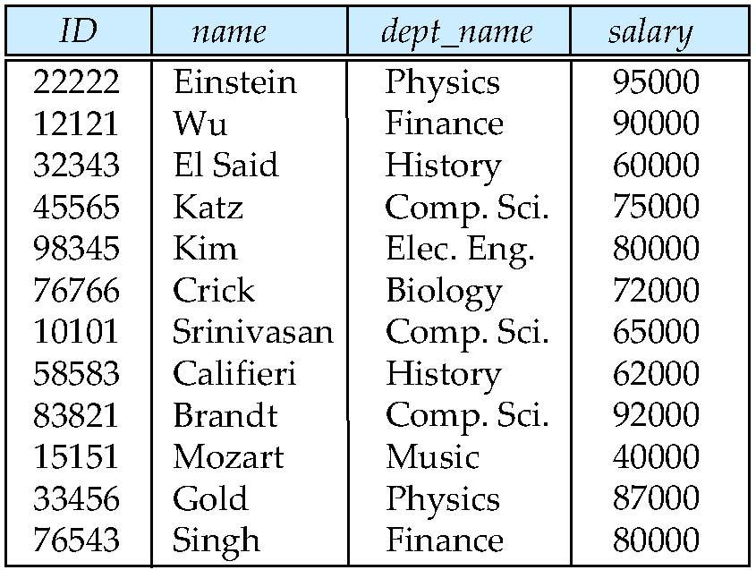
Relations are Unordered
Order of tuples is irrelevant (tuples may be stored in an arbitrary order)
Example: instructor relation with unordered tuples
Notes:
43

Slide 44
Database
A database consists of multiple relations
Information about an enterprise is broken up into parts
instructor student advisor
Bad design: univ (instructor -ID, name, dept_name, salary, student_Id, ..) results in
repetition of information (e.g., two students have the same instructor)
the need for null values (e.g., represent an student with no advisor)
Normalization theory (Chapter 7) deals with how to design “good” relational schemas
Notes:
44

Slide 45
Keys
Let K ⊆ R
K is a superkey of R if values for K are sufficient to identify a unique tuple of each possible relation r(R)
Example: {ID} and {ID,name} are both superkeys of instructor.
Superkey K is a candidate key if K is minimal Example: {ID} is a candidate key for Instructor
One of the candidate keys is selected to be the primary key.
which one?
Foreign key constraint: Value in one relation must appear in another
Referencing relation
Referenced relation
Notes:
45

Slide 46
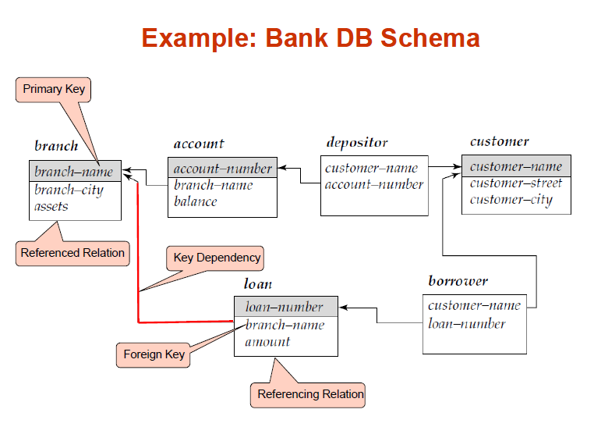

Slide 47
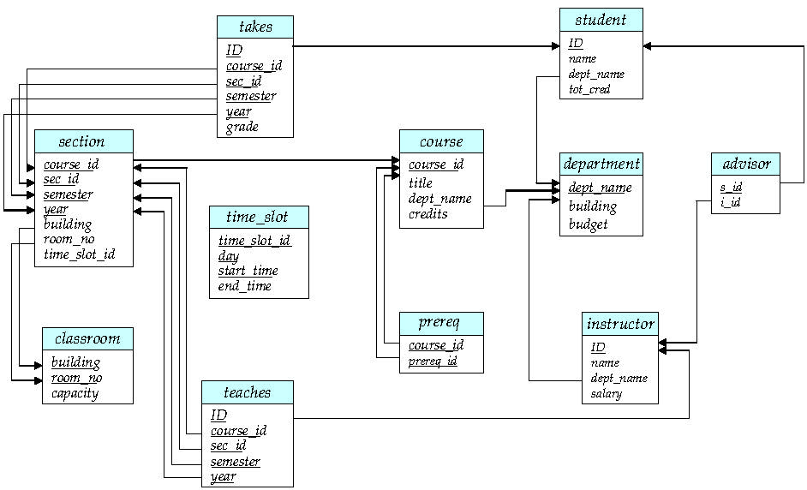
Schema Diagram for University Database

Slide 48
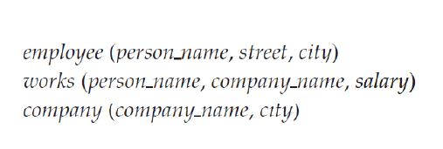
Exercise 1.2 What are appropriate Primary Keys ?

Slide 49
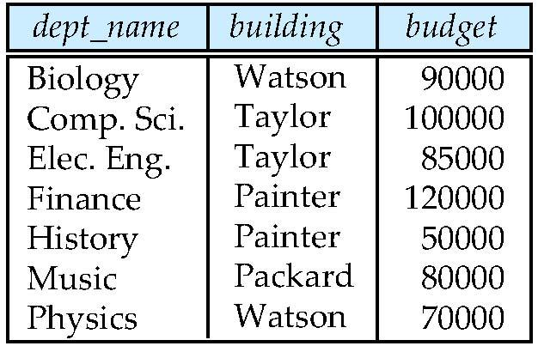
Exercise 1.3 Give an example insert that would violate the foreign key constraint ?
Exercise 1.4 Give an example Delete that would violate the foreign key constraint ?

Slide 50
Exercise 1.5 From the Database Instance of Instructor shown no two instructors have the same name. From this observation can we conclude that name can be used as a superkey (primary key) of instructor ?

Slide 51
Relational Query Languages
Procedural vs.non-procedural, or declarative
“Pure” languages:
Relational algebra
Tuple relational calculus
Domain relational calculus
Relational operators
Relational Algebra operators
Six basic operators
Select: σ
Project: Π
Union: ∪
set difference: –
Cartesian product: x
Rename:
The operators take one or two relations as inputs and produce a new relation as a result.
Notes:
51

Slide 52
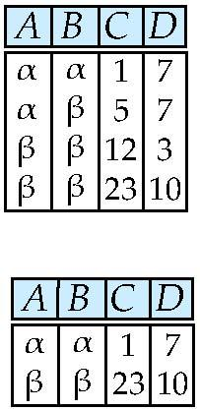
Selection of tuples
Relation r
Select tuples with A=B and D > 5
σ _{A=B and D > 5} (r)
Notes:
52

Slide 53
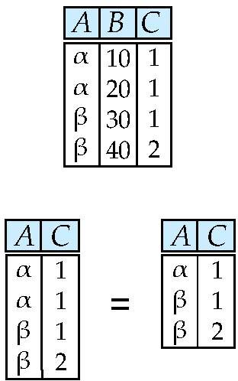
Selection of Columns (Attributes)
Relation r:
Select A and C Projection
Π _{A, C} (r)
Notes:
53

Slide 54
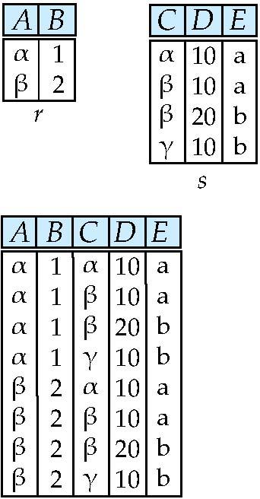
Joining two relations – Cartesian Product
Relations r, s:
r x s:
Notes:
54

Slide 55
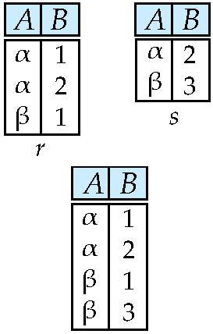
Union of two relations
Relations r, s:
r ∪ s:
Notes:
55

Slide 56
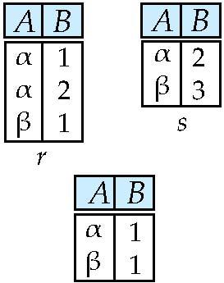
Set difference of two relations
Relations r, s:
r – s:
Notes:
56

Slide 57
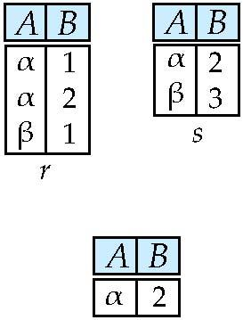
Set Intersection of two relations
Relation r, s:
r ∩ s
Notes:
57

Slide 58
Joining two relations – Natural Join
Let r and s be relations on schemas R and S respectively. Then, the “natural join” of relations R and S is a relation on schema R ∪ S obtained as follows:
Consider each pair of tuples t_{r} from r and t_{s} from s.
If t_{r} and t_{s} have the same value on each of the attributes in R ∩ S, add a tuple t to the result, where
t has the same value as t_{r} on r
t has the same value as t_{s} on s
Notes:
58

Slide 59
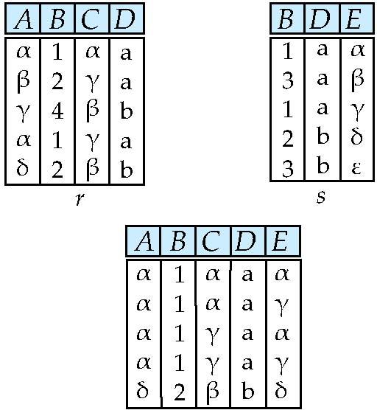
Natural Join Example
Relations r, s:
Natural Join
r s
Notes:
59

Slide 60
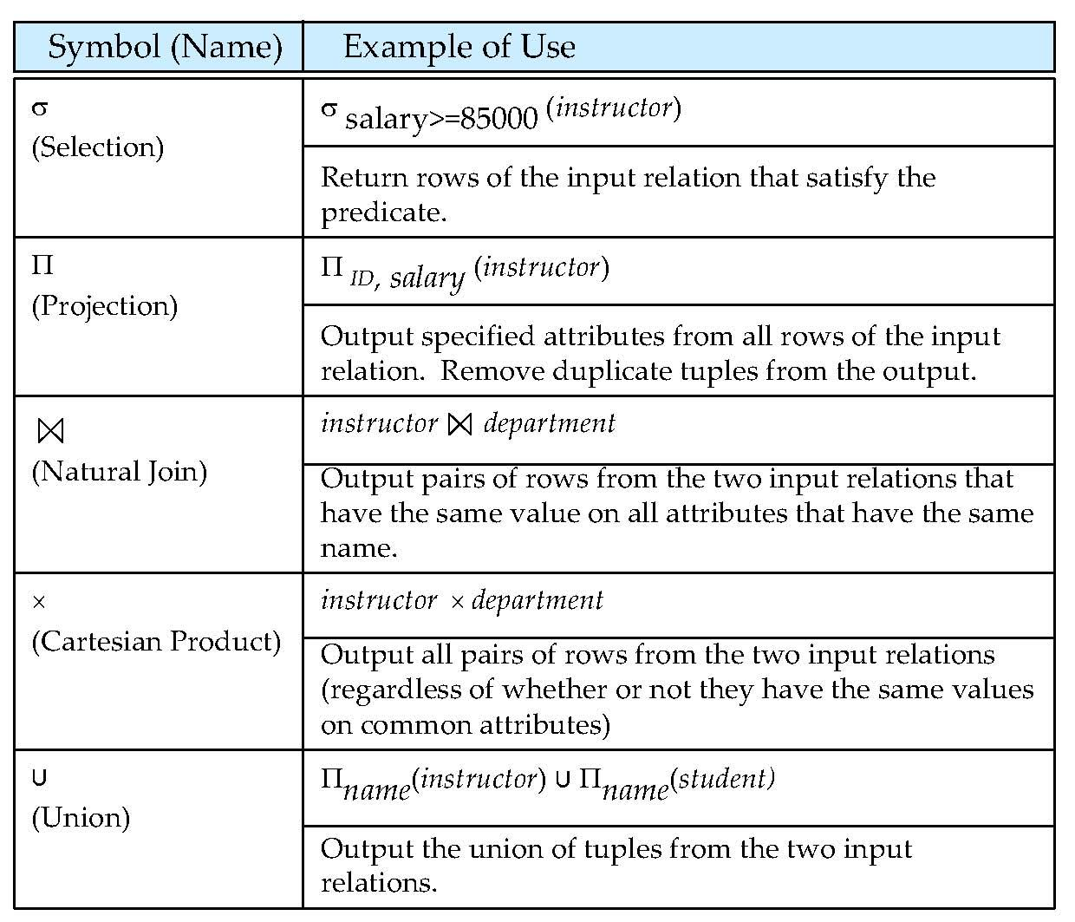
Figure in-2.1
Notes:
60

Slide 61
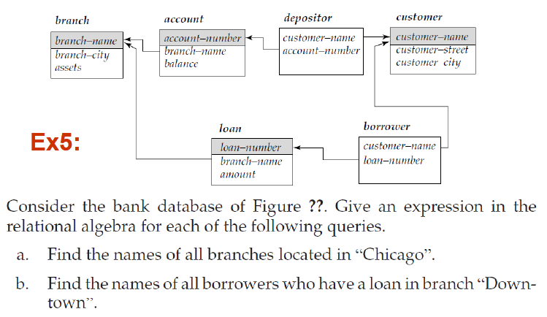
Exercise 1.6

Slide 62
Exercise 1.7
Employee(emp_no, emp_name, emp_city, …….)
Assignment(proj_no, emp_no, hours,……….)
Project(proj_name, budget, proj_no, proj_start_date, proj_end_date, proj_location,……..)
Express each of the following queries in Relational Algebra:
List the name(s) and budget(s) of projects started before 1st May 2008.
List the name(s) of projects with a budget value above Rs. 1,000,000.
Find the name(s) of employees who are from city “Moratuwa”.
Find the name(s) of employees who are from city “Moratuwa” and work on projects located in “Moratuwa”.
Find the name(s) of employees who work on projects valued above Rs. 1,000,000.

Slide 63
End of Chapter 2
Notes:
63

Slide 64
Figure 2.01
Notes:
64

Slide 65
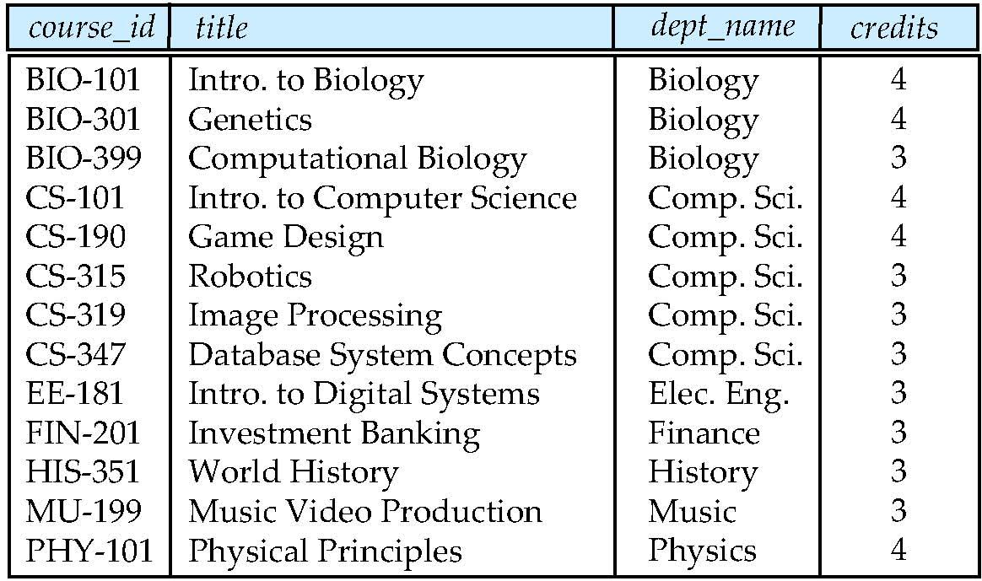
Figure 2.02
Notes:
65

Slide 66
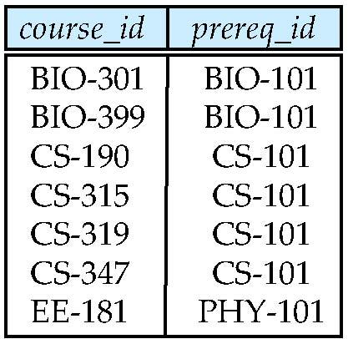
Figure 2.03
Notes:
66

Slide 67
Figure 2.04
Notes:
67

Slide 68
Figure 2.05
Notes:
68

Slide 69
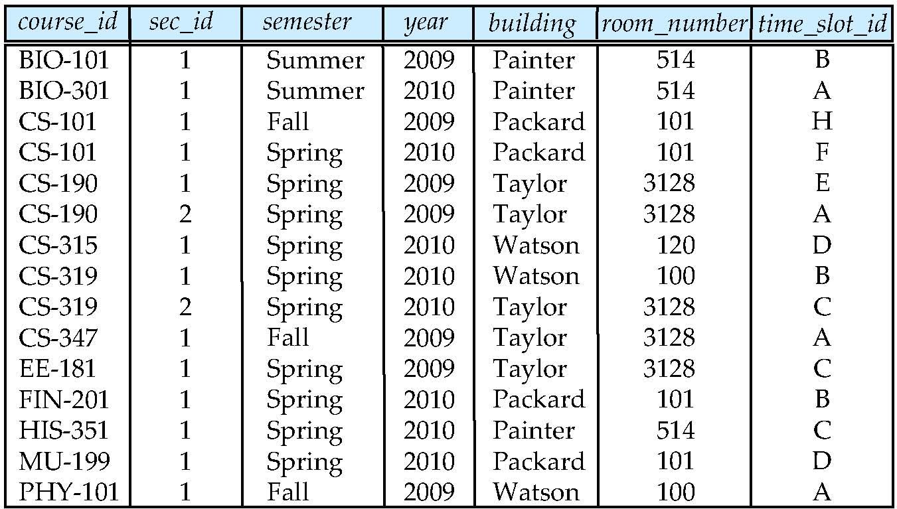
Figure 2.06
Notes:
69

Slide 70
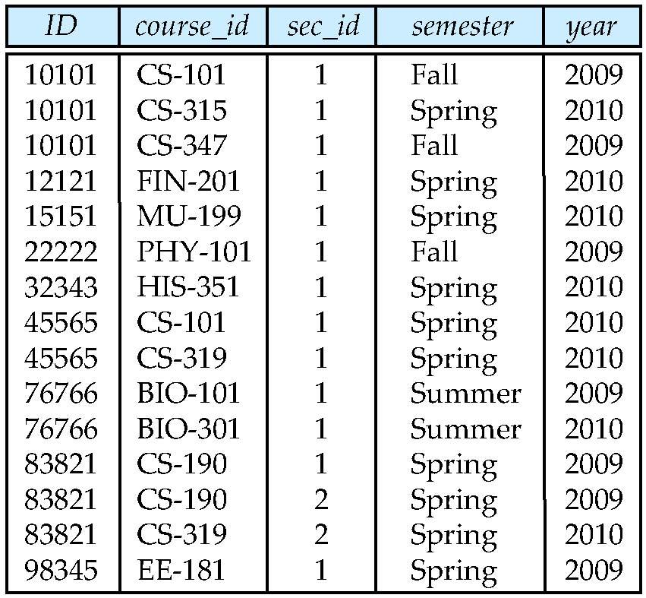
Figure 2.07
Notes:
70

Slide 71
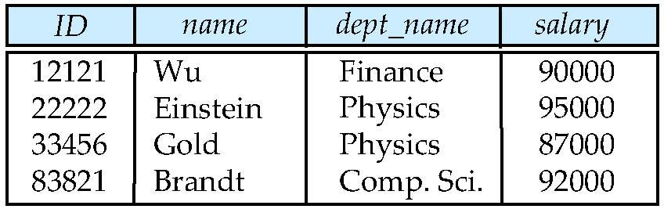
Figure 2.10
Notes:
71

Slide 72
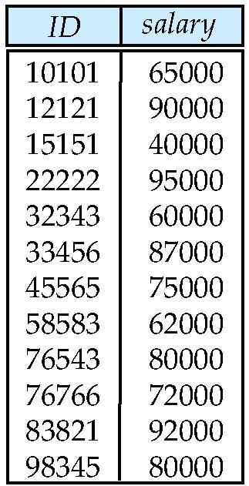
Figure 2.11
Notes:
72

Slide 73
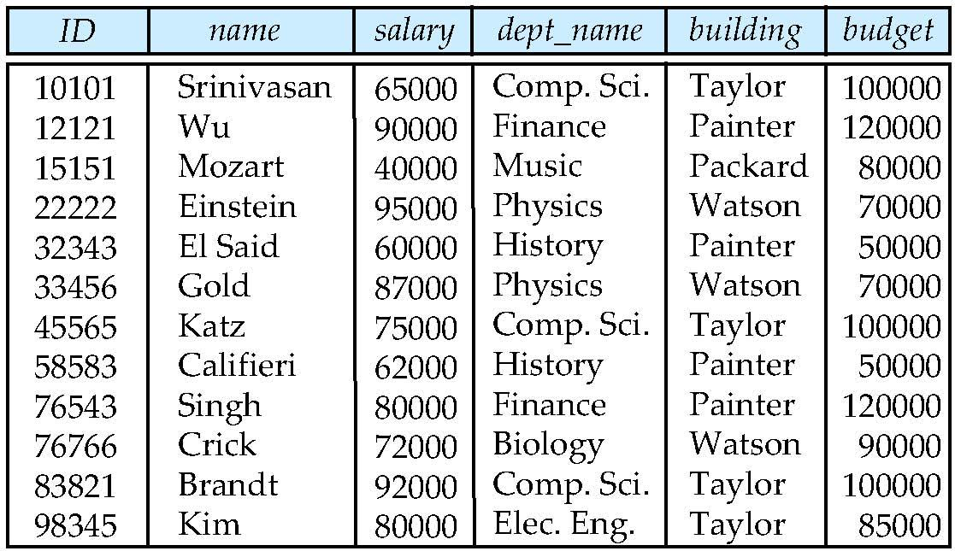
Figure 2.12
Notes:
73

Slide 74
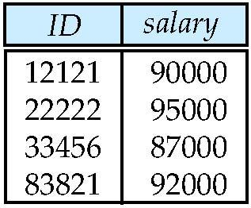
Figure 2.13
Notes:
74

Slide 75

Figure 1.02

Slide 76
Figure 1.04

Slide 77
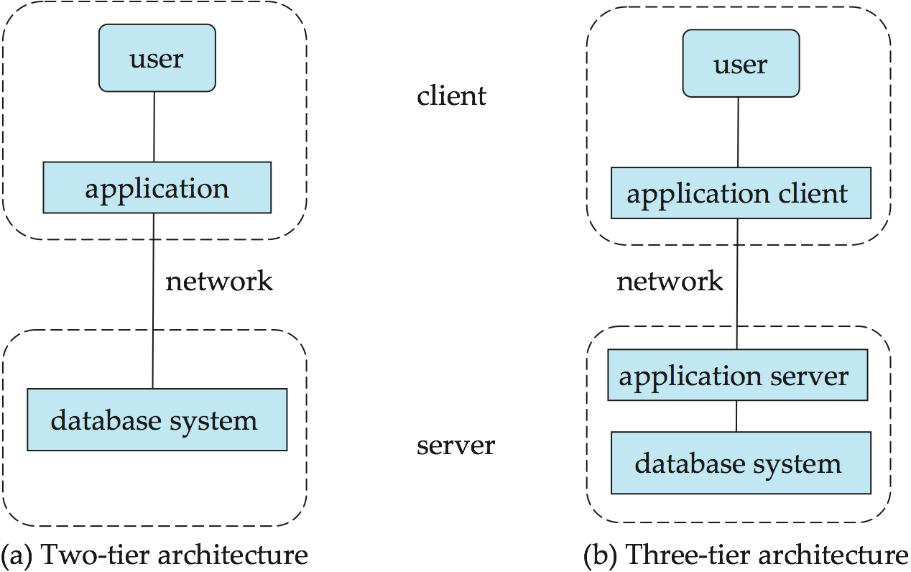
Figure 1.06

